Slide 1




Are algorithms controlling or are we too dependent?
5 – 10 years old
Do you feel like you can’t leave without your tablet?
Yeah! I need it to play games with my friends !!
And what about you?
There’s nothing to do… I play Roblox cause I get really bored

Slide 2
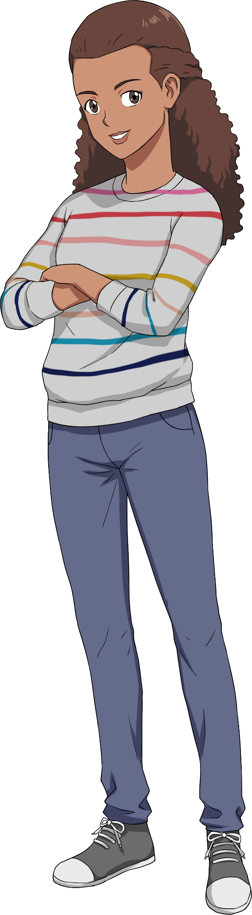
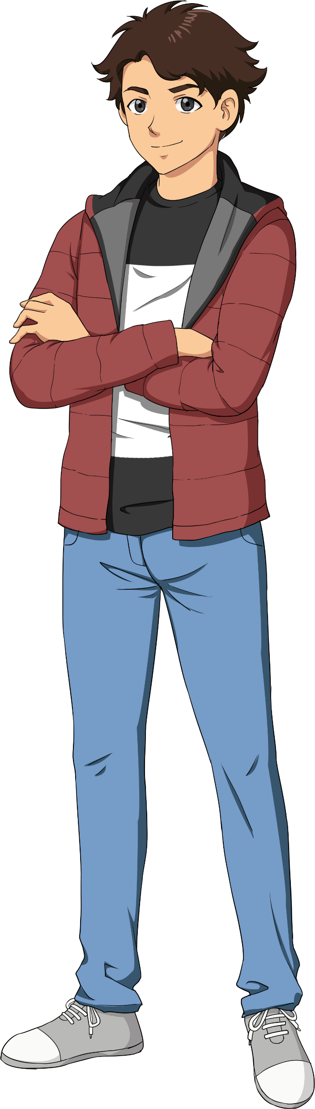
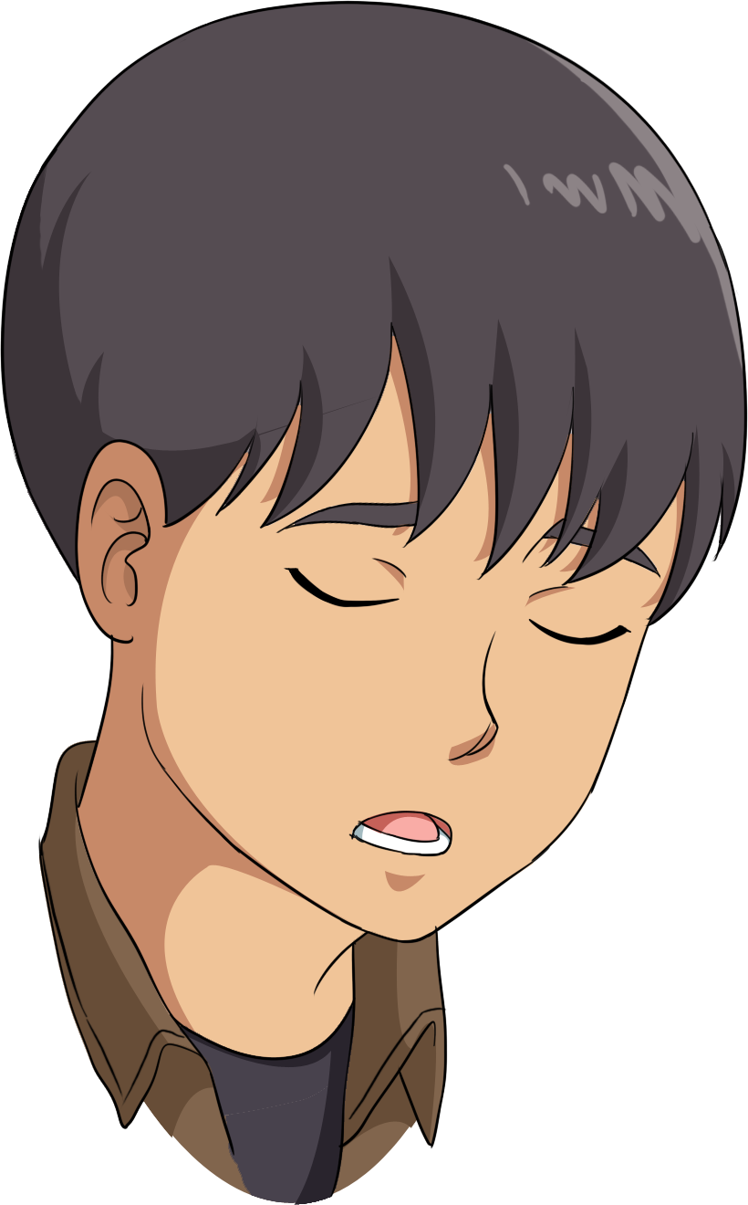
Are algorithms controlling or are we too dependent?
11 - 18 years old
Obviously, you know about technology and algorithms but do you think you are too dependent on them?
I don’t think I’m THAT dependent on technology, though I do think that the government or, yes, algorithms do control what we see or what is advertised to us.
Honestly, I’m not going to lie. I am addicted to my phone, I literally spend hours on TikTok and the thing is I know it but I can’t stop myself.

Slide 3
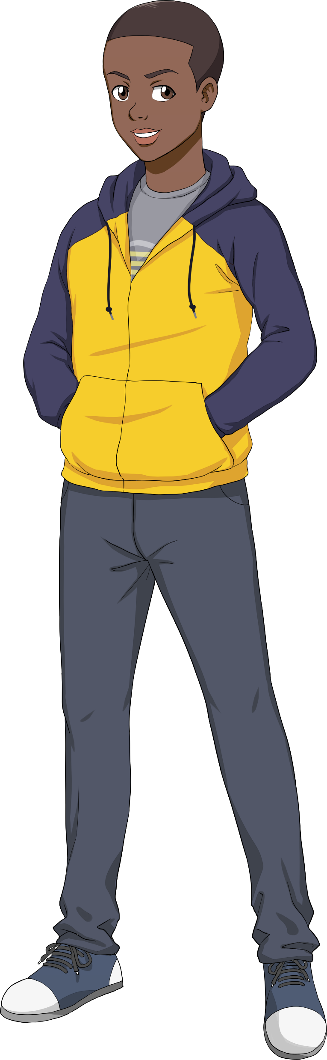
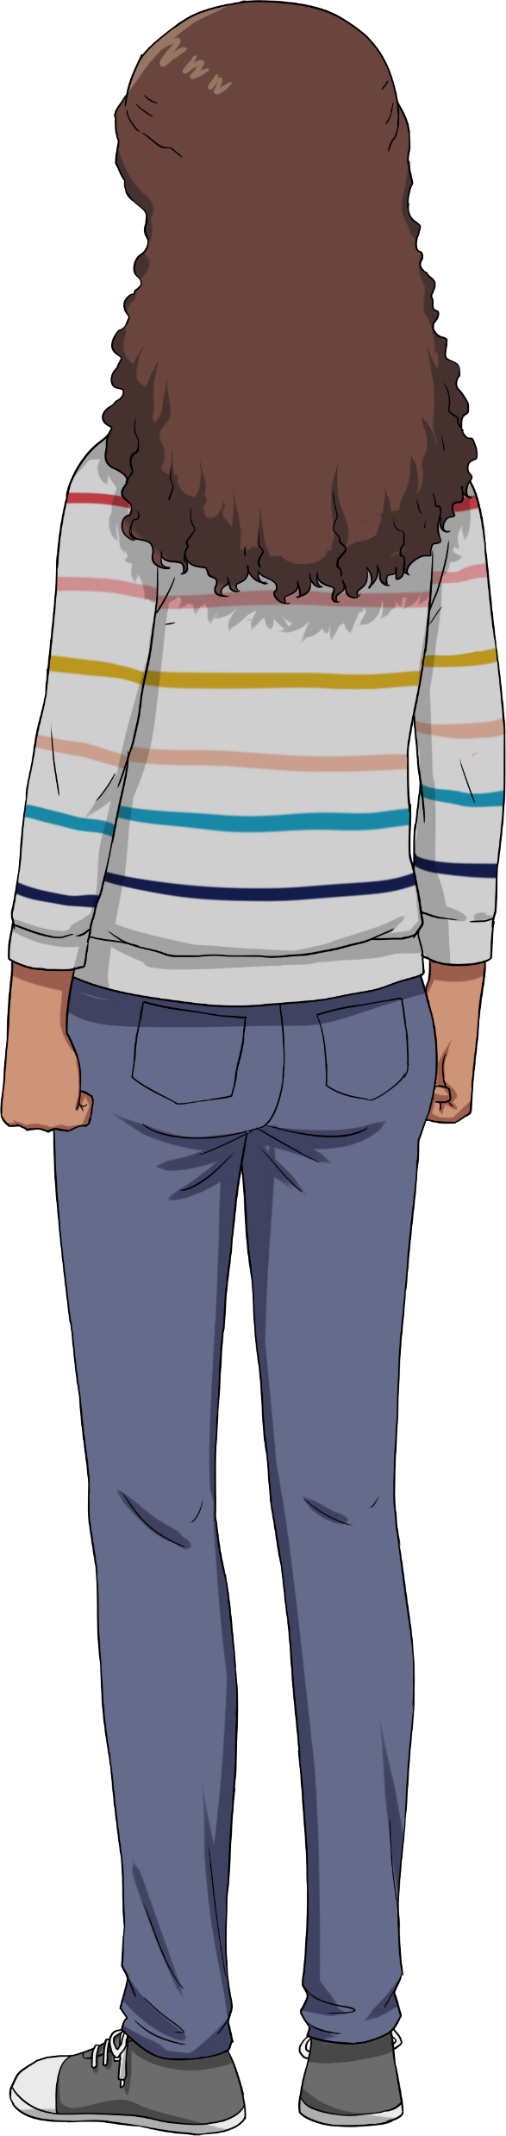
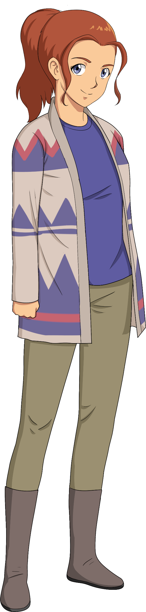
Are algorithms controlling or are we too dependent?
19 - 35 years old
Are you familiar with algorithms, if not, have you noticed specific ads that pop up or suggestions?
I’m not really well versed in algorithms but I know what you mean about specific ads popping up. It is scary because I don’t want to get scammed, so I try to be as careful as I can.
Yeah! Sometimes I’m tempted to buy things that the algorithm suggests to me but I do in a way find that controlling. I never really thought of that before.

